Slide 1

Unit-3 Helpers & Routing
Web Programming using .NET
#2305CS311
Prof. Madhuresh R Fichadiya
Computer Science & Engineering Department
madhuresh.fichadiya@darshan.ac.in
8866961282

Slide 2

Outline
Introduction to Helpers
Helpers
Tag Helpers
HTML Helpers
Standard Tag Helpers
Strongly Typed HTML Helpers
Anchor Tag Helper
Routing
Conventional Routing
Attribute Routing
Action Selectors
Action Filters
Case Study
Types of Action Filter
Looping

Slide 3
Introduction to Helpers
Section 3.1

Slide 4
Introduction to Helpers
Helpers are utility components that simplify the process of generating HTML content and handling common tasks in web applications.
They enhance code readability and promote a cleaner separation between business logic and UI rendering.
Helpers are primarily categorized into the following:
HTML Helpers
These are methods used in Razor views to render standard HTML elements such as text boxes, checkboxes, dropdowns, etc.
Ex: @Html.TextBoxFor(model => model.Name)
Tag Helpers
Introduced in ASP.NET Core, Tag Helpers enable server-side code to participate in creating and rendering HTML elements using natural HTML syntax.
<input asp-for="Email" class="form-control" />

Slide 5
Tag Helpers
Section 3.2

Slide 6
Tag Helpers
Tag Helpers are classes written in C# but are attached to HTML elements in order to run server-side code from Razor view.
It enable server-side code to participate in creating and rendering HTML elements in Razor files.
There are many built-in Tag Helpers for common tasks, such as creating forms, links, loading assets etc.
Tag Helpers are authored in C#, and they target HTML elements based on the element name, the attribute name, or the parent tag.
For example, the built-in LabelTagHelper can target the HTML <label> element when the LabelTagHelper attributes are applied.
If you are familiar with HTML Helpers, Tag Helpers reduce the explicit transitions between HTML and C# in Razor views.

Slide 7
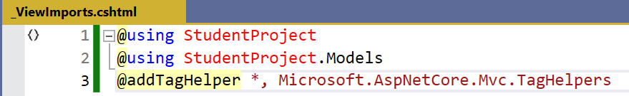
Using a Tag Helpers
To use the inbuilt or custom Tag Helpers, one has to first reference Tag Helper library named Microsoft.AspNetCore.Mvc.TagHelpers.
It can also be taken from Nuget.
It using @AddTagHelper directive as shown below inside _ViewImports.cshtml,
In the above line, all the Tag helpers will be imported which are mentioned in 'Microsoft.AspNetCore.Mvc.TagHelpers' assembly.
Whatever it is referenced/imported inside _ViewImports.cshtml will be available for all the views.

Slide 8
Common Built-in Tag Helpers
These Tag Helpers are provided by default as part of the ASP.NET Core framework.
They cover common scenarios and tasks, making generating HTML with dynamic behavior easier, such as generating links, creating forms, loading assets, showing validation messages, etc. Some examples of built-in Tag Helpers include:
<a asp-controller=”Home” asp-action=”Index”>Link</a>: Generates a link with a URL that’s generated by routing based on the specified controller and action.
<img src=”~/images/pic.jpg” asp-append-version=”true” />: Generates a <img> tag with a cache-busting query string to ensure the latest version of the image is fetched.
<form asp-controller=”Account” asp-action=”Login” method=”post”>…</form>: Generates a form element with the appropriate action attribute for the specified controller and action.
<input asp-for=”Username” />: Generates an input field with attributes based on the model property specified by asp-for.
<span asp-validation-for="Username" class="text-danger"></span>: Generates a username validation message with specified control.

Slide 9
Built-in Tag Helpers Cont..
Attribute | Asp Attribute Name | Description
area | asp-area | The name of the Area
controller | asp-controller | The name of the MVC controller
action | asp-action | The name of the action method on an MVC controller
route | asp-route | The name of the route
route- | asp-route-* | A single route parameter value
Fragment | asp-fragment | This is particularly useful when you want to link to a specific section of a page.
host | asp-host | Web Host or Generic Host | Configures a server and request processing pipeline
page | asp-page | The Razor page to link to
protocol | asp-protocol | The protocol (http, https, ftp etc)

Slide 10
HTML Helpers
Section 3.2.1

Slide 11
Introduction: HTML Helpers
HTML Helpers are classes that can generate html tags in Razor view pages.
An HTML Helper is just a method that returns a HTML string.
The string can represent any type of content that you want.
For example, you can use HTML Helpers to render standard HTML tags like HTML <input>, <button> and <img> tags etc.
It also binds the model object to HTML controls to display the value of model properties into those controls and also assigns the value of the controls to the model properties while submitting a web form.
So, we can always use the HtmlHelper class in razor view instead of writing HTML tags manually.
Starts with @Html is an object of the HtmlHelper class. (@ symbol is used to access server-side object in razor syntax)

Slide 12
Built-In HTML Helpers
Standard Html Helpers
Strongly Typed HTML Helpers (Model Binding)

Slide 13
Standard HTML Helpers
Section 3.2.2

Slide 14
1. Standard HTML Helpers
HTML Element | Example
TextBox | @Html.TextBox("txtLastName", “Last Name")
TextArea | @Html.TextArea("txtAddress", "Enter Address", 5, 15, null)
Password | @Html.Password("txtPassword", "123")
Hidden Field | @Html.Hidden("Hidden1", "val")
CheckBox | @Html.CheckBox("Checkbox1", false)
RadioButton | @Html.RadioButton("Radiobutton1", "val", true)
Drop-down list | @Html.DropDownList("DropDownList1", new SelectList(new [] {"Male", "Female"}))
Multiple-select | @Html.ListBox("ListBox1", new MultiSelectList(new [] {"Cricket", "Chess"}))
ActionLink | @Html.ActionLink("Click here", // <-- Link text "About", // <-- Action Method Name "Home", // <-- Controller Name null, // <-- Route value null // <-- html Arguments )

Slide 15
Strongly Typed HTML Helpers
Section 3.2.3

Slide 16
2. Strongly Typed HTML Helpers
HTML Element | Example
TextBoxFor | @Html.TextBoxFor(m=>m.Name, new {@class="form-control",@placeholder="Enter User Name",@style="color:red"})
TextAreaFor | @Html.TextAreaFor(m=>m.Address, 5, 15, new{}))
PasswordFor | @Html.PasswordFor(m=>m.Password)
HiddenFor | @Html.HiddenFor(m=>m.StudentId)
CheckBoxFor | @Html.CheckBoxFor(m=>m.IsDetained)
RadioButtonFor | @Html.RadioButtonFor(m=>m.IsDetained)
DropDownListFor | @Html.DropDownListFor(m => m.Gender, new SelectList(new [] {"Male", "Female"}), “Select Gender")
ListBoxFor | @Html.ListBoxFor(m => m.Hobbies, new MultiSelectList(new [] {"Cricket", "Chess“,”Music”}))

Slide 17
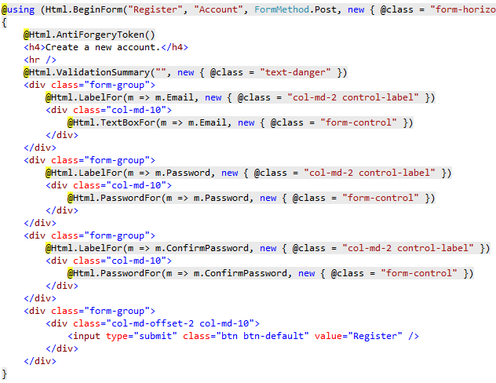
Example: Strongly Typed HTML Helpers

Slide 18
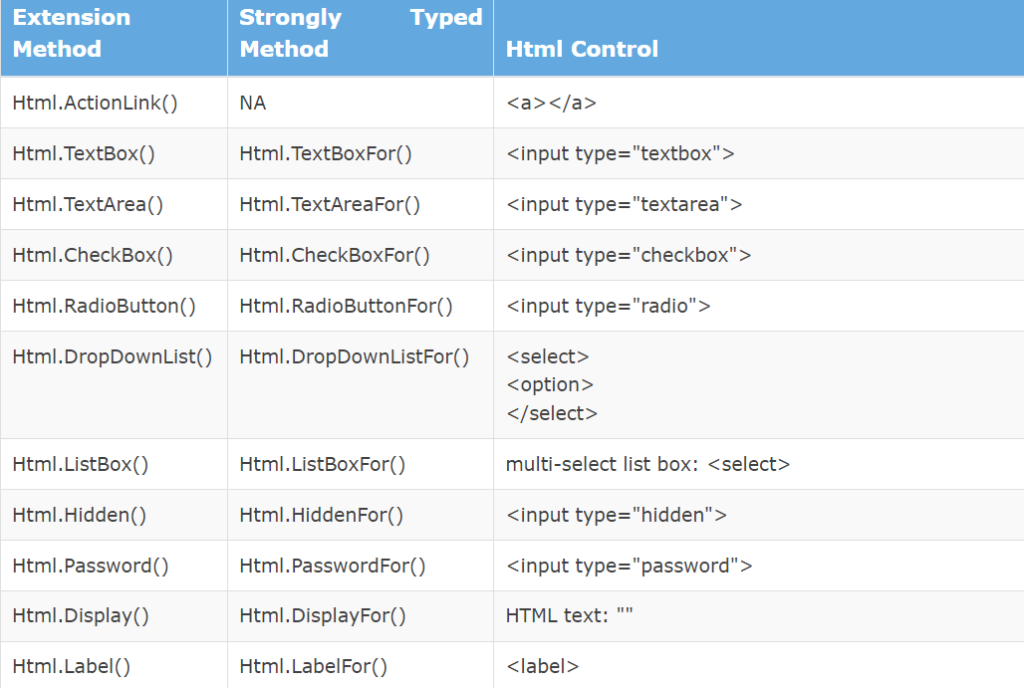
Summary

Slide 19
Difference: Standard HTML v/s Strongly Typed HTML v/s Tag Helpers
Feature | Standard HTML Helper | Strongly Typed HTML Helper | Tag Helper
Syntax Style | Method call with string | Method call with lambda expression | HTML-like tag with asp-* attributes
Example | @Html.TextBox("UserName") | @Html.TextBoxFor(m => m.UserName) | <input asp-for="UserName" />
Model Binding | Not directly bound to model | Directly bound to model | Directly bound to model
Readability | Moderate | Better | Best
Maintainability | Prone to errors | Easier to maintain | Very easy to maintain
HTML-like Syntax | No | No | Yes
Recommendation | Avoid in modern projects | Good for forms | Best practice in ASP.NET Core

Slide 20
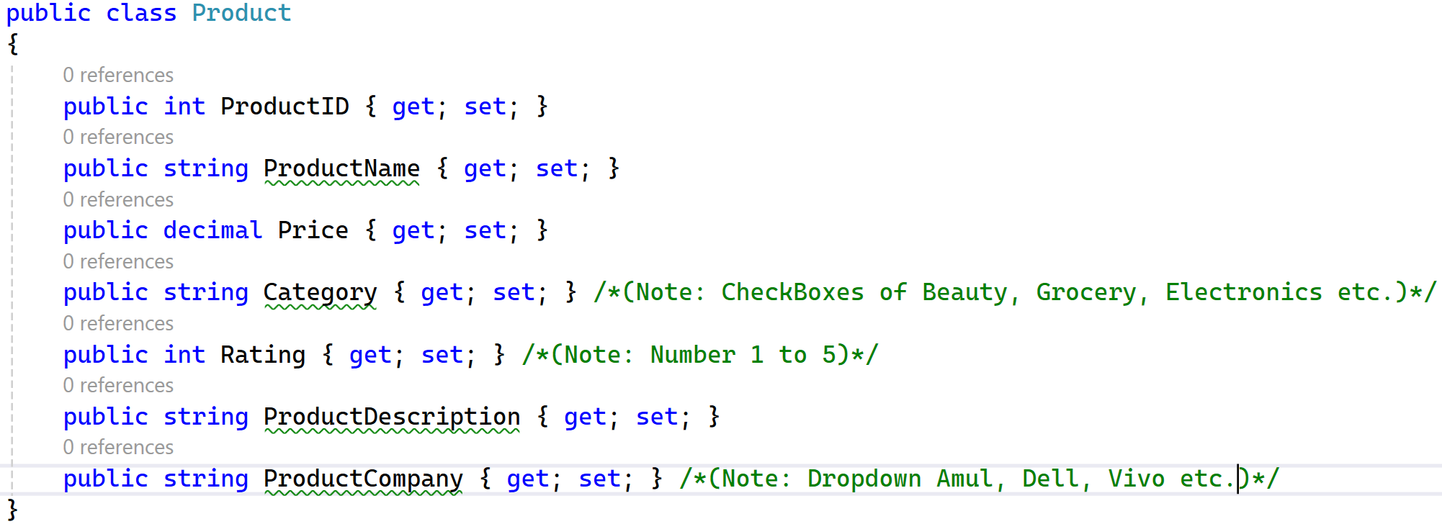
Practice: Create a Form With Strongly Typed HTML Tag Helper

Slide 21
Anchor Tag Helpers
Section 3.2.4

Slide 22
Anchor Tag Helper
This tag helper is used generate href attributes to link to a particular controller action or MVC route.
This tag helper is an alternative to using @Html.ActionLinkor @Url.Action helper methods.
For example, the following code in a Razor view:
@Html.ActionLink("Register Yourself","RegisterMethod", "Account") <a href="@Url.Action("RegisterMethod", "Account")">Register Yourself</a>
It will generate two identical anchor html tags.
<a href="/Account/RegisterMethod">Register Yourself </a> <a href="/Account/RegisterMethod">Register Yourself </a>
Using the anchor tag helper, we can generate the same HTML as above by adding the asp-controller and asp-action attributes to an anchor tag as follows:
<a asp-controller="Account“ asp-action="RegisterMethod">Register Yourself</a>

Slide 23
Anchor Extension Methods Cont..
Using ActionLink
1
2
3
4
<p>This link is generated in the View:</p>
@Html.ActionLink("Simple link to a 'Home' controller 'Index' action",
“Index”, "Home")
</p>
Using Anchor Tag
1
2
3
4
5
<p>This link is generated in the View:</p>
<a asp-controller="Home"
asp-action="Index">Simple link to a 'Home' controller 'Index' action
</a>
</p>
Using URL Action
1
2
3
4
5
<p>This link is generated in the View:</p>
<a href="@Url.Action("Index", "Home")">
Simple link to a 'Home' controller 'Index' action
</a>
</p>

Slide 24
ActionLink Extension Method Cont..
Get a link to the current controller’s action
1
@Html.ActionLink("Link to Index action", "Index")
Get a link to specific controller and action:
1
@Html.ActionLink("Link to Index action of Home controller", "Index", "Home")
Get a link to specific controller and action with parameters
1
2
3
@Html.ActionLink("Link to Index action of Home controller with id=100500 and
name='John Doe'", "Index", "Home",
new { id = 100500, name = "John Doe" })
Get a link to specific controller and action and set css class for the link
1
2
3
4
@Html.ActionLink("Link to Index action of Home controller with id=100500 and
name='John Doe' and CSS class", "Index", "Home",
new { id = 100500, name = "John Doe" },
new { @class="css-class"})

Slide 25
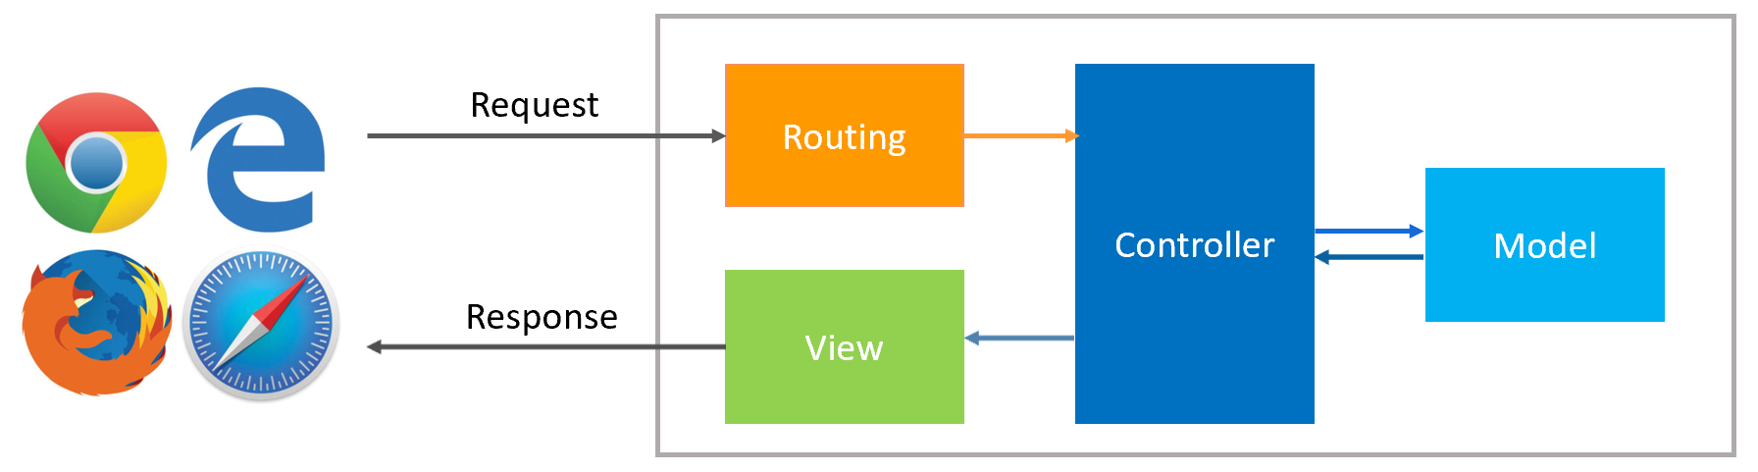
Routing
Section – 3.3

Slide 26
Introduction: Routing
The Routing in the ASP.NET Core MVC Web Application is a mechanism in which it will inspect the incoming HTTP Requests (i.e. URLs) and then mapped that HTTP request to the controller’s action method.
It is the process through which the application matches an incoming URL path and executes the corresponding action methods.
You can configure multiple routes for your application and for each route, you can also set some specific configurations such as default values, constraints, etc.
We can define the routes either in the startup code (Program.cs) or as attributes (Route[]).
It describes how we can match the URL paths with the specific action methods.
We can also use routes to generate URLs for links that are sent out in responses as per our requirements.
There are two types of routing for action methods:
Conventional Routing OR Convention-Based Routing
Attribute Routing OR Attribute-Based Routing

Slide 27
1. Conventional Routing
Section 3.3.1

Slide 28
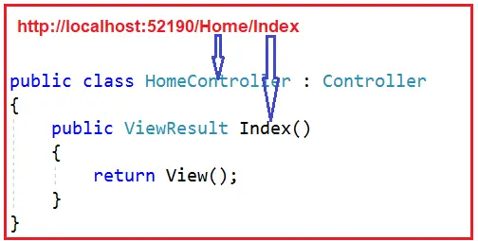
1. Conventional Routing
In Conventional Based Routing, the route is determined based on the conventions defined in the Routing Middleware which will map the incoming HTTP Requests (i.e. URLs) to controller action methods.
From .NET 8, you can configure the Convention Based Routes within the Main method of the Program class.
In the ASP.NET Core MVC Web Application, it is the controller action method that is going to handle the incoming HTTP Requests i.e. URLs.
For example, if we issue a request to the /Home/Index URL, then it is the Index action method of the Home Controller class that is going to handle the request as shown in the below image.

Slide 29
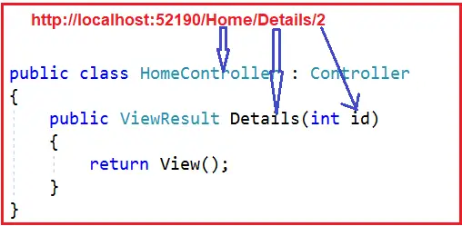
1. Conventional Routing Cont..
Similarly, if we issue a request to the /Home/Details/2 URL, then it is the Details action method of the Home Controller class that is going to handle the request as shown in the below image.
Here the parameter value 2 is automatically mapped to the id parameter of the Details action method.
Now, the question that should come to your mind is, we have not explicitly defined any routing rules for the application, then how does this mapping is done i.e.
How the /Home/Index URL is mapped to the Index action method and how /Home/Details/2 URL is mapped to the Details action method of the Home Controller class.
This is actually done by the MVC Middleware Component which we registered in the application’s Request Processing Pipeline.

Slide 30
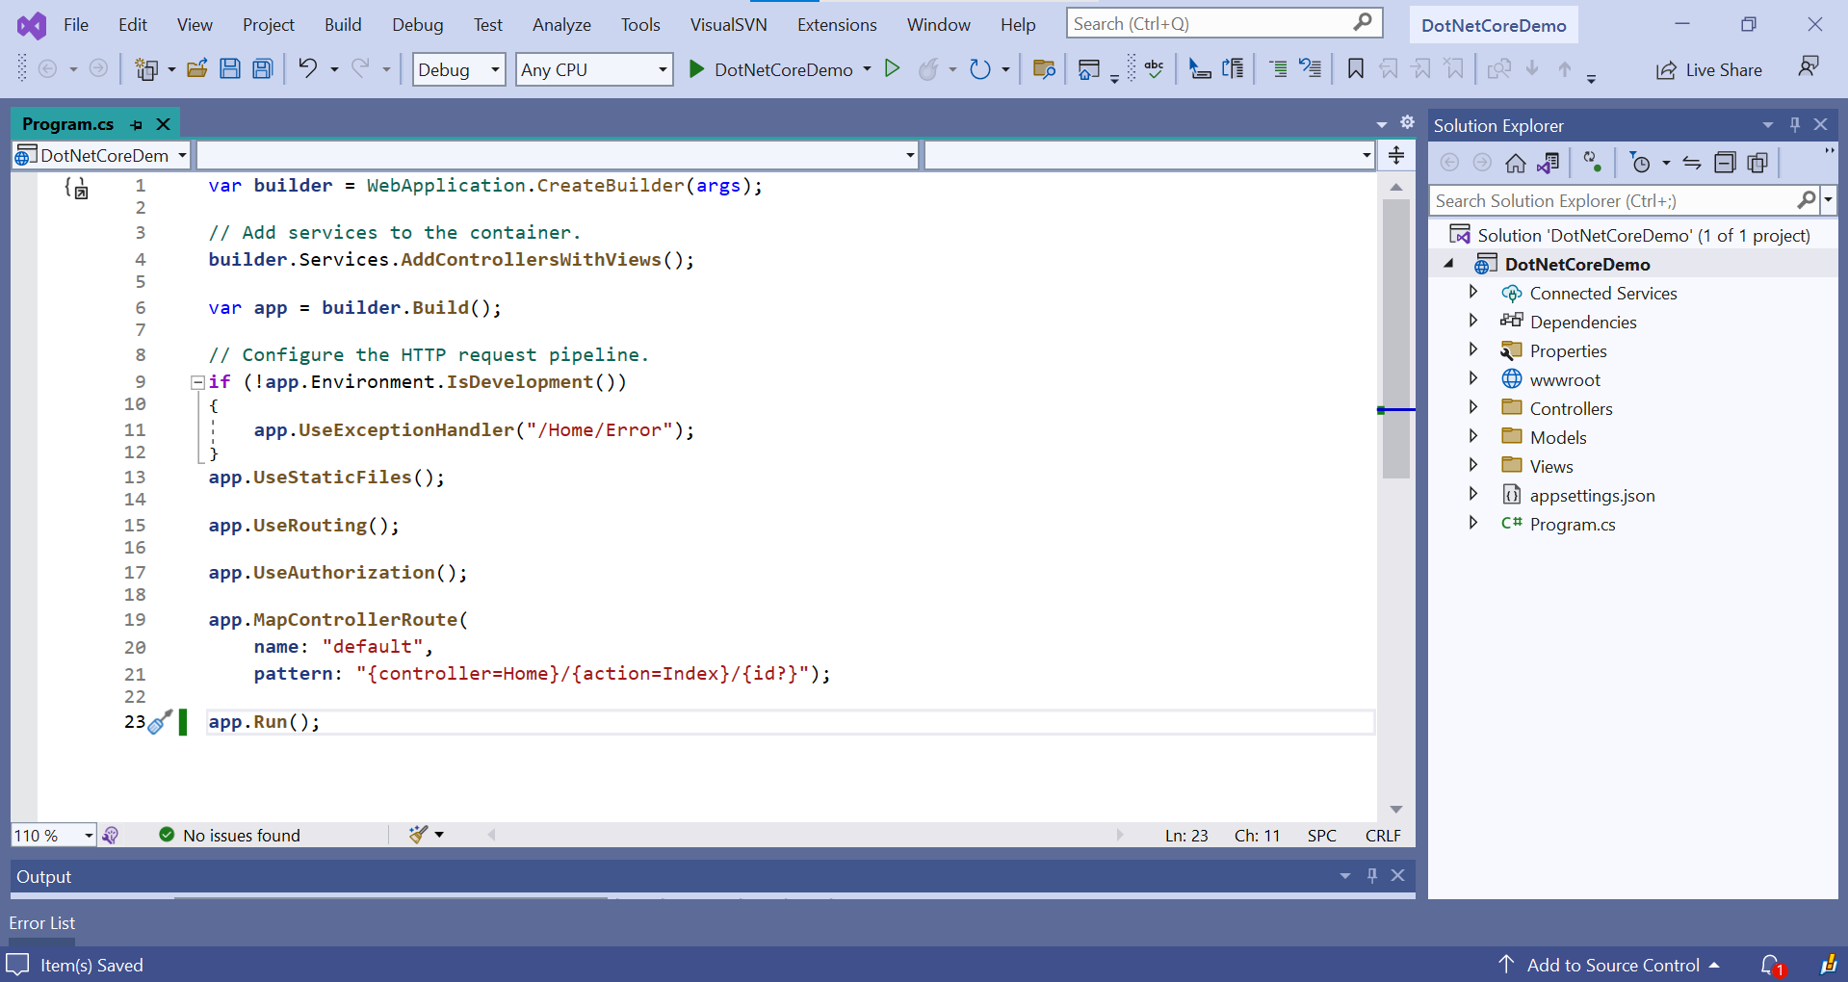
Program.cs
The default route is created with the following URL Pattern.
So, if we don’t specify anything in the URL, then by default the Index action method of the Home Controller class is going to handle the request.
{controller=Home}/{action=Index}/{id?}
This is Required for Routing
This will define the route pattern along with the Default Route

Slide 31
Example
public class StudentController : Controller
{
public string Index()
{
return "Index() Action Method of StudentController";
}
public string Details(int? id)
{
return $"Details({id}) Action Method of StudentController";
}
}
Now, the URL “/student/index” is mapped to the Index() action method of the StudentController class, and the URL “/student/details” or “/student/details/5” both are mapped to the Details(int? id) action method of the StudentController.

Slide 32
Attribute Routing
Section 3.3.2

Slide 33
Attribute Routing Cont..
Attribute Routing can be done via four different ways.
Action Method Level
Controller Level
With Parameters
With Optional Parameters
How to Ignore the route?

Slide 34
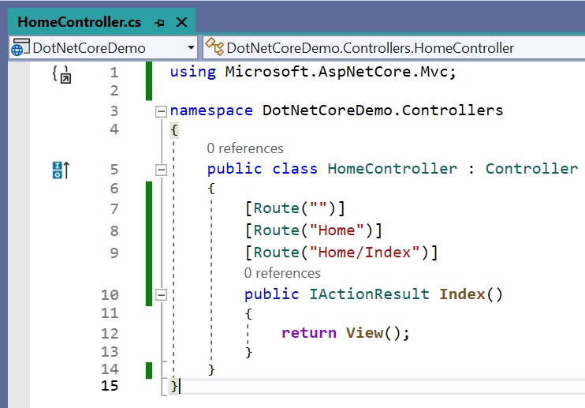
1. Attribute Routing (Action Method Level)
With the help of ASP.NET Core Attribute Routing, you can use the Route attribute to define routes for your application.
You can use the Route attribute either at the Controller level or at the Controller Action Methods level.
When you apply the Route attribute at the Controller level, then it is applicable for all the action methods of that controller.
Let us modify the Home Controller as shown here.
Here we have applied the Route Attribute at the Action method.

Slide 35
2. Attribute Routing (Action Method Level) Cont..
If you notice, here we applied the Route() attribute 3 times on the Index() action method of Home Controller.
The point that you need to remember is, with each instance of the Route attribute we specified a different route template.
With the above three Route attribute, now we can access the Index() action method of the HomeController using the following 3 URLs.
http://localhost:5280/
http://localhost:5280/Home
http://localhost:5280/Home/Index

Slide 36
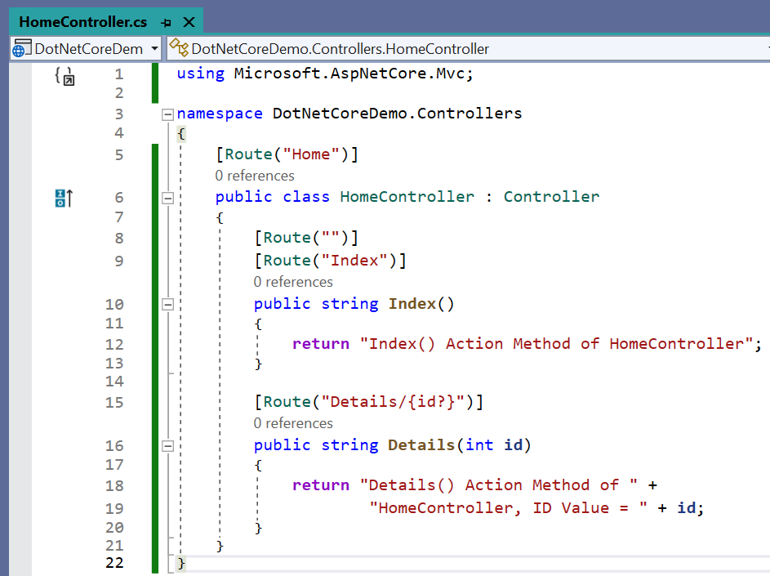
2. Attribute Routing (Controller Level) Cont..
In the ASP.NET Core MVC application, it is also possible to apply the Route() attribute on the Controller class as well as on individual action methods.
If you want to make the attribute routing less repetitive, then you need to use the route attributes on the controller level as well as on the individual action methods level.
The Route template applied on the controller level is prepended to the route template applied to the action method level.

Slide 37
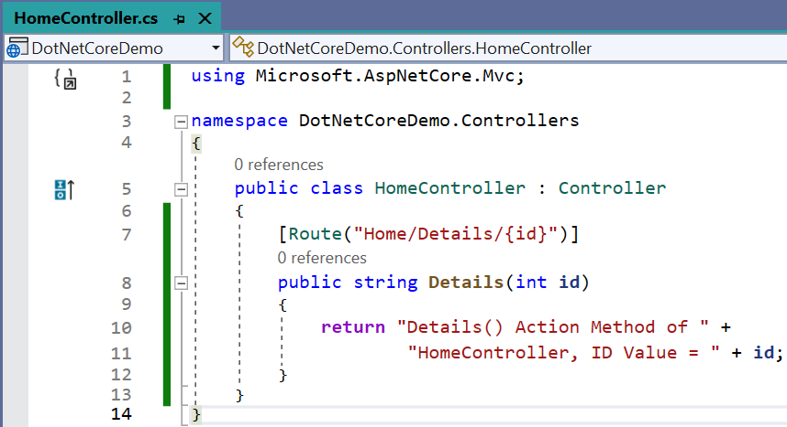
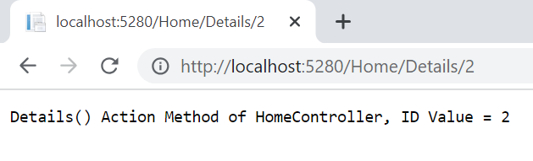
3. Attribute Routing (With Parameters)
With conventional based routing, we can specify the route parameters as part of the route template.
We can also do the same with attribute routing. That means we can also define Route Attribute with parameters.
To understand this, modify the Home Controller as shown here.
This is done by a process called Model binding.
Output

Slide 38
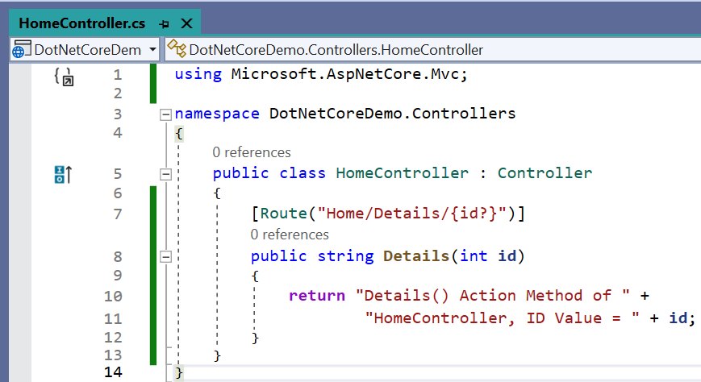
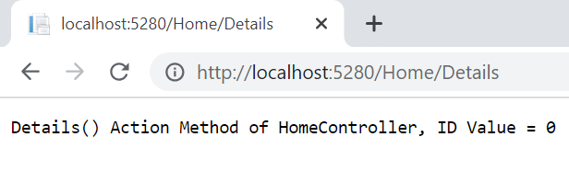
4. Attribute Routing (With Optional Parameters) Cont..
Like conventional based routing, we can also make a parameter as optional in Attribute Routing.
To make the Route parameter optional, simply add a question mark “?” at the end of the parameter.
Now, we check the output with given images.
Output

Slide 39
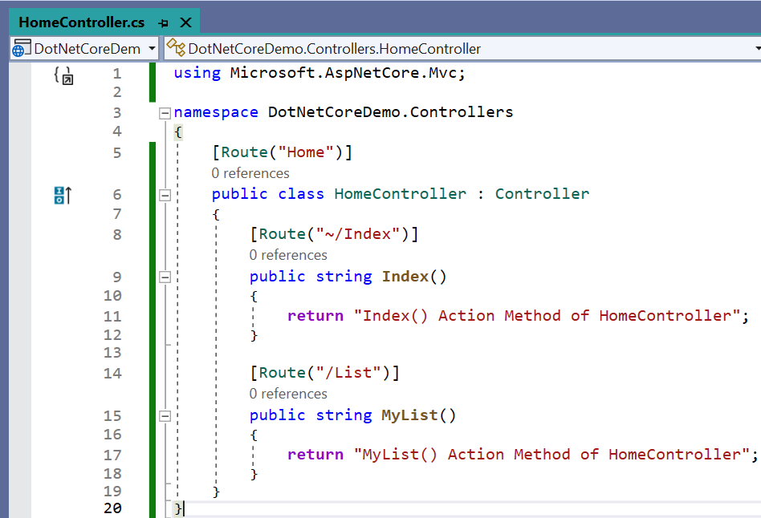
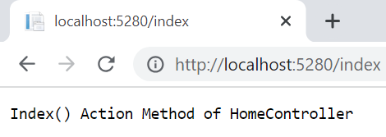
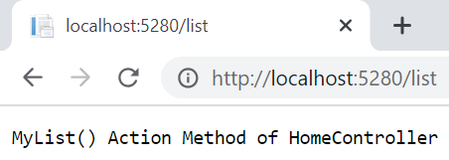
5. How to ignore the Route Template placed at the Controller Level?
In order to ignore the Route Template placed at the Controller level, you need to use / or ~/ at the action method level.
If the action method route template starts with / or ~/, then the controller route template is not going to be combined with the action method route template.
Output

Slide 40
Adding Route Parameters
In some cases, you might need to specify additional parameters for the controller action that you are binding to.
You can specify values for these parameters by adding attributes with the asp-route- prefix.
For example, you might need to specify the id of a product you are linking to, you would add a asp-route-id attribute as follows:
<a asp-controller="Product"
asp-action="Display"
asp-route-id="@ViewBag.ProductId"> View Product
</a>
<a asp-controller="Product"
asp-action="Display"
asp-route-productid="@ViewBag.ProductId"> View Product
</a>
It will generate the following html when ViewBag.Id = 1:
<a href="/Product/Display/1">View Details</a>

Slide 41
Action Selectors
Section – 3.4

Slide 42
Action Selectors
The ActionVerbs selector is to handle different type of Http requests.
The MVC framework includes HttpGet, HttpPost, HttpPut, HttpDelete and HttpPatch action verbs.
You can also apply one or more action verbs to an action method to handle different HTTP requests.
If you don't apply any action verbs to an action method, then it will handle HttpGet request by default.
APIs are increasingly using action verbs.
Selectors like this are used to ensure that the Action method is controlled based on the HTTP method.

Slide 43
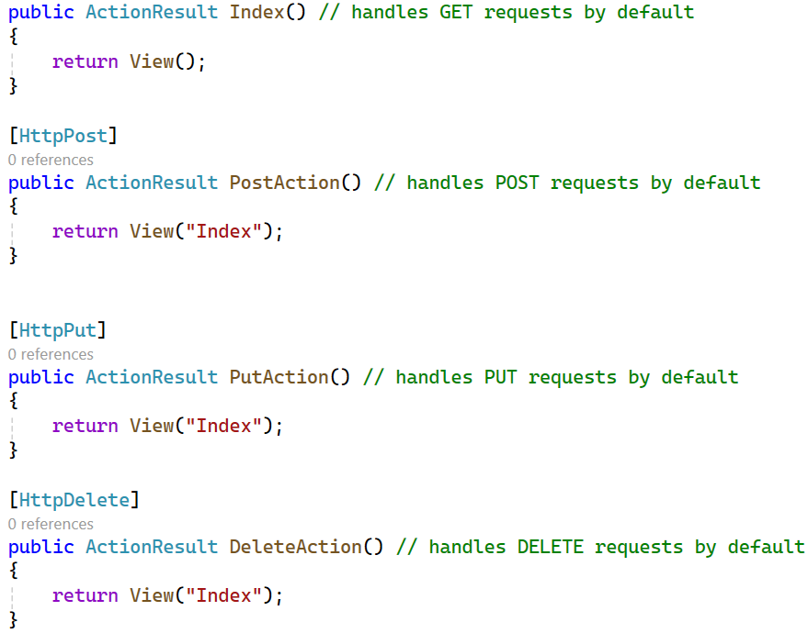
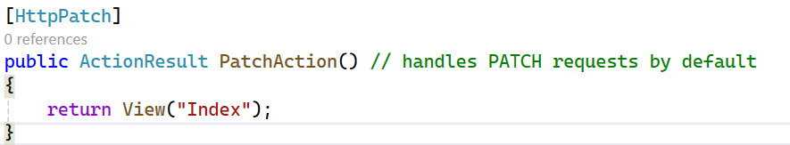
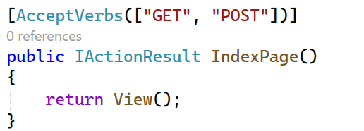
Action Selectors Cont..
You can also apply multiple action verbs using the AcceptVerbs attribute, as shown below.

Slide 44
Action Filters
Section – 3.5

Slide 45
Intro: Action Filters
In ASP.NET MVC, a user request is routed to the appropriate controller and action method.
However, there may be circumstances where you want to execute some logic before or after an action method executes.
Filters also help to avoid code-duplication in our projects.
ASP.NET Core supports both synchronous and asynchronous filters.
The main difference when implementing such filters is the selection of the appropriate interface.
Synchronous filter interfaces define two methods that are executed before and after a specific stage in the filter pipeline.
The method that is executed before has a name that ends with Executing and the method that is executed after has a name that ends with Executed.

Slide 46
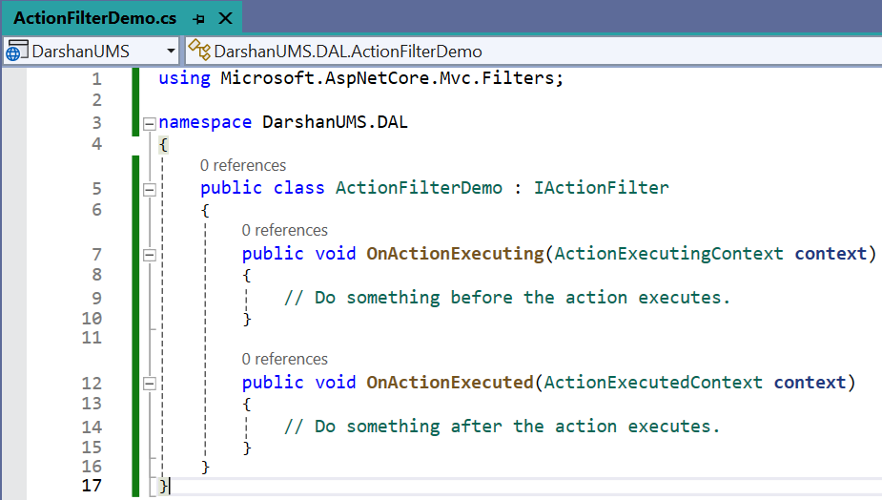
Intro: Action Filters Cont..
What is difference between middleware and filters in .NET Core?
Middlewares operate on each and every request coming to a .NET Core app on the other hand Filters operated only on request coming to MVC pipeline.
We can run filters on specified actions and controllers (cannot do this on Middlewares) unless we register the filter globally in the program class.

Slide 47
Case Study: Built-in Filters
Section - 3.5.1

Slide 48
Case Study : Built-in Filter – [RequireHttps]
The [RequireHttps] attribute is a built-in filter which on applying to a controller or an action method allows only HTTPS requests to reach them.
This means non-HTTPS requests are simply blocked.
When we created the app with Model-View-Controller template it will automatically redirect all requests made towards non-https endpoints to their respective HTTPS endpoints.

Slide 49
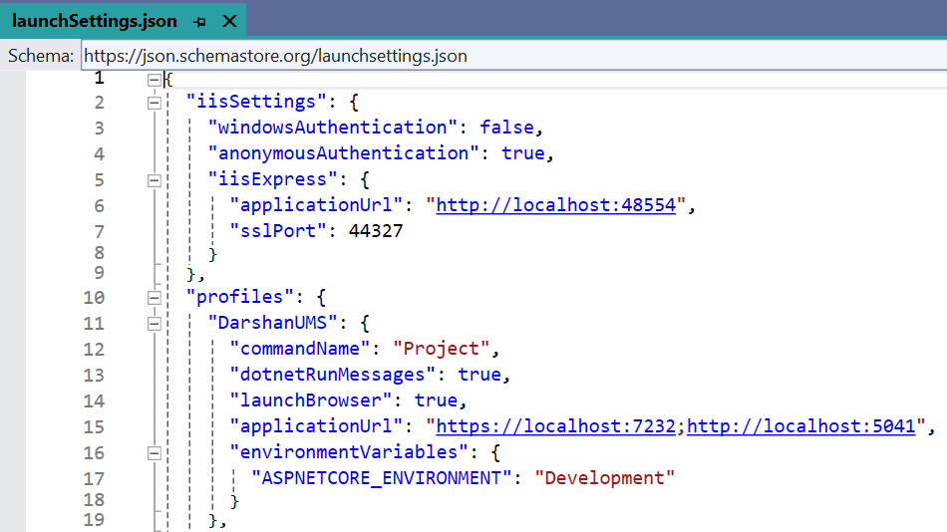
Case Study : Built-in Filter – [RequireHttps] Cont..
Open and check the launchSettings.json file given inside the “Properties” folder.
Here two urls are given for the “applicationUrl” property under “profiles”.
The second url is the non-https url for the app, which in our case here is http://localhost:5041.
Now run the app and open the non-https based url on the browser.
We will see the browser immediately redirects us to the HTTPS based url or the app.

Slide 50
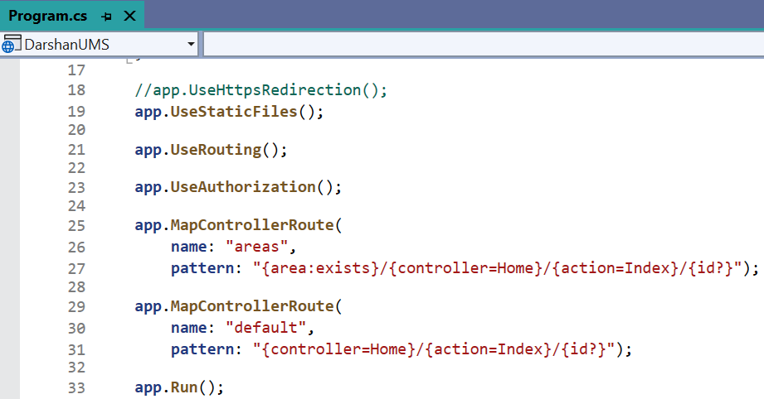
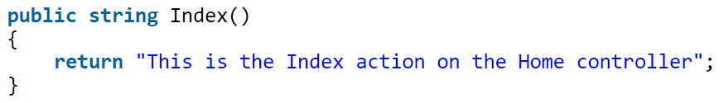
Case Study : Built-in Filter – [RequireHttps] Cont..
Now run the app and open the non-https based url on the browser. We will see the browser immediately redirects us to the HTTPS based url or the app.
In order to understand [RequireHttps] filter we first need to disable this redirection. So open the Program.cs file and comment the code line app.UseHttpsRedirection(); which does this redirection.
Now re-run the app and open the non-https url on the browser, and this time it will not get redirected.
Next, we change the Index Action method of Home Controller to return a string message as shown below:

Slide 51
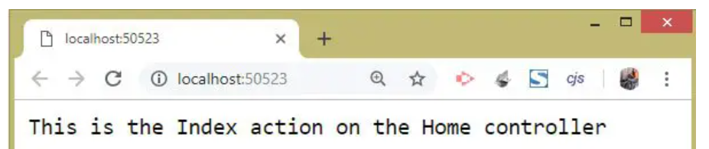
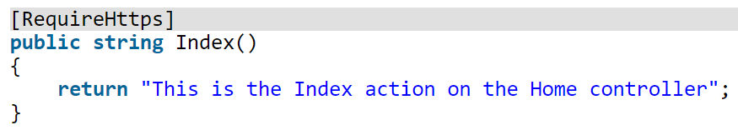
Case Study : Built-in Filter – [RequireHttps] Cont..
Now run your application and open the “non-https” url of the app on the browser. We will see the message on the browser, see the below image:
Now we make this action method to only be accessed from an HTTPS request, we do this by adding the [RequireHttps] attribute over the action method.

Slide 52
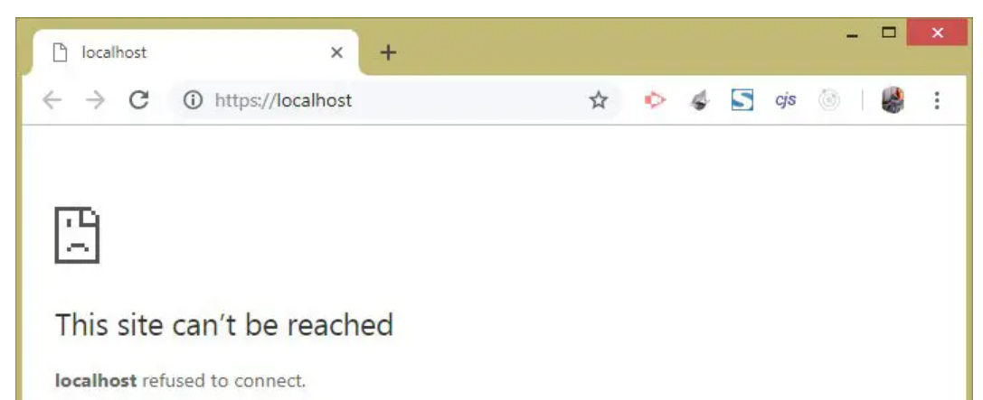
Case Study : Built-in Filter – [RequireHttps] Cont..
Re-run the app and once again open the non-https url of the app.
We will get another message saying – This site can’t be reached, as shown in the image given below:
The reason is because we are trying to invoke the action method with a Non-HTTPS request but the [RequireHttps] attribute blocks it.
The [RequireHttps] built-in filter can also be applied on the controllers class. In that case all the controller’s action methods will get this attribute and they will block all non-https requests.

Slide 53
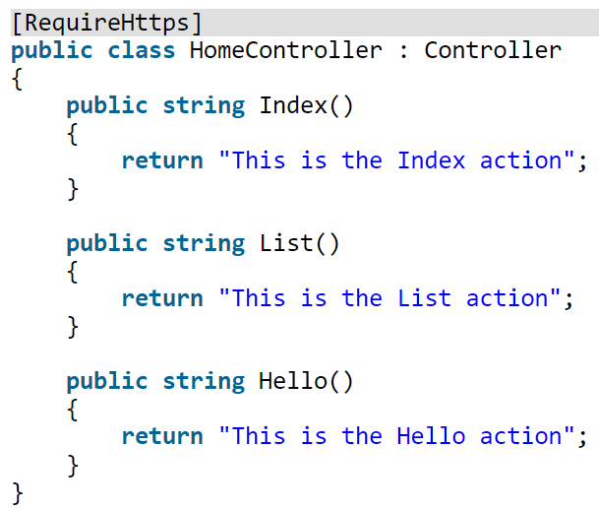
Case Study : Built-in Filter – [RequireHttps] Cont..
At Controller level, all the 3 action methods will get RequireHttps attribute.

Slide 54
Types of Action Filters
Section – 3.5.2

Slide 55
Types of Action Filters
Authorization Filter
Resource Filter
Action Filter
Result Filter
Exception Filter

Slide 56
Types of Action Filters Cont..
There are 4 major types of filters in .NET Core.
These are Authorization, Action, Result and Exception.
A filter can work both in synchronous and asynchronous way.
Filter | Interfaces that contains them | Description
Authorization | IAuthorizationFilter, IAsyncAuthorizationFilter | Used to apply authorization and security policy
Action | IActionFilter, IAsyncActionFilter | Used to perform a specify work immediately before or after an action method is performed
Result | IResultFilter, IAsyncResultFilter | Used to perform a specify work immediately before or after the result from an action method is processed
Exception | IExceptionFilter, IAsyncExceptionFilter | Used to handle exceptions

Slide 57
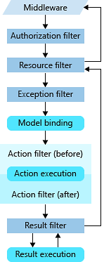
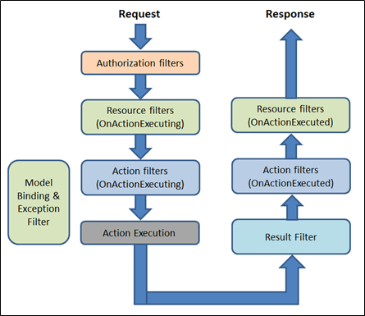
Execution order of Filters
Authorization Filters are the first to execute.
Next comes the Action Filters.
At the last the Result Filters are executed.
The Exception Filters are executed only when exceptions occur.

Slide 58
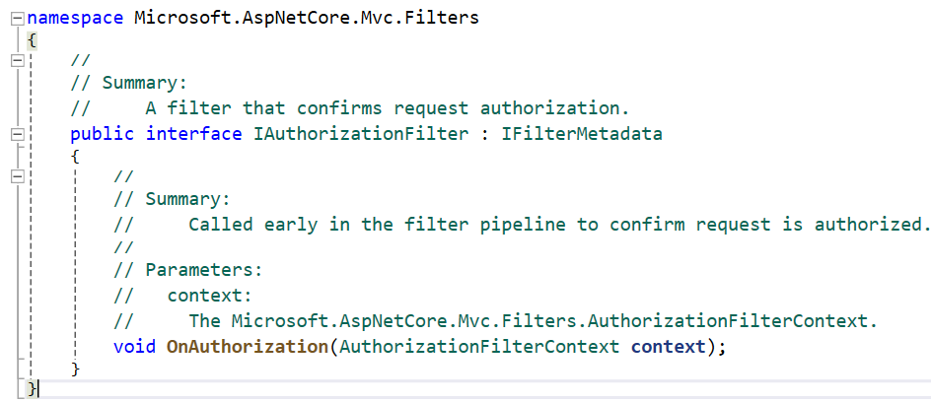
1. Authorization Filters
Authorization Filters are used to authorize a user to access a resource.
Authorization filters are applied to a controller or an action method using the [Authorize] decoration.
Authorization filters are contained by IAuthorizationFilter and IAsyncAuthorizationFilter interfaces.
Authorization filters implement the IAuthorizationFilter interface which has one method, OnAuthorization().
The Authorization Filters are used for authorization purpose and creating security policy. These filters run first in the pipeline.

Slide 59
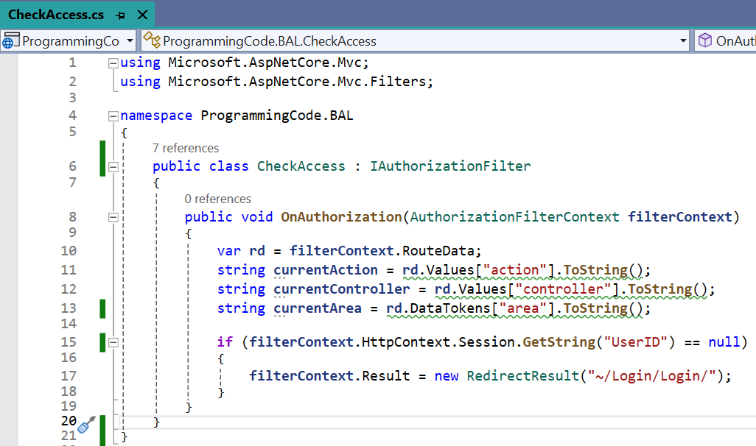
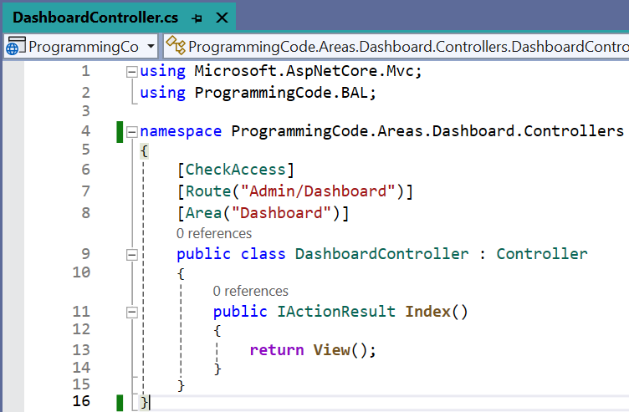
1. Authorization Filters - Example

Slide 60
2. Action Filters
Action filters are one of the most commonly used filters to perform additional data processing, or manipulating the return values or cancelling the execution of action or modifying the view structure at run time.
Action Filters in ASP.NET Core are attributes that allow you to add logic that runs before and after the execution of individual action methods in your controllers.
These filters are used to perform tasks such as logging, input validation, modifying the action result, and more.
The Action Filters are executed before and after an action method is executed.
They are second in the order of execution in the filter pipeline i.e. are executed after the Authorization Filters.
It can change the arguments passed into an action.
It can change the result returned from the action.
These are not supported in Razor Pages.

Slide 61
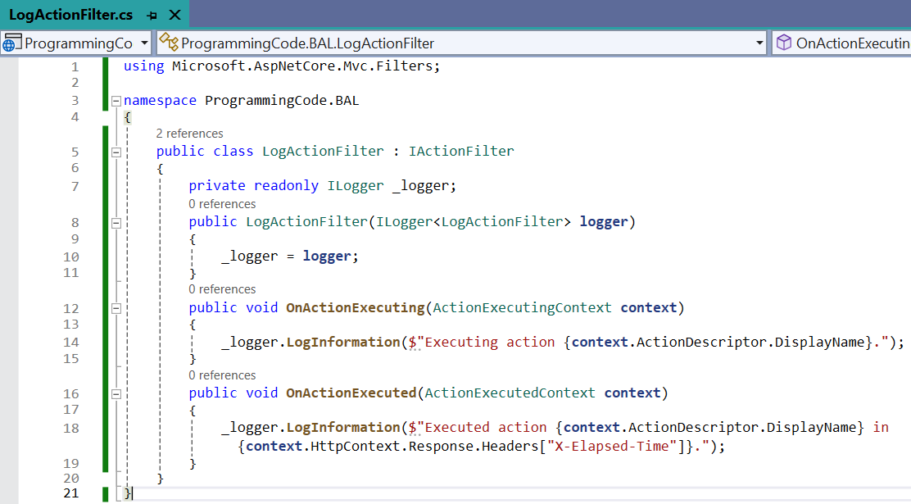
2. Action Filters - Example
When we apply an Action Filter on an Action method, the OnActionExecuting method is called just before the action method is invoked, and the OnActionExecuted method is called just after the action method has finished execution.

Slide 62
3. Result Filters
Result filters are only executed when an action or action filter produces an action result.
Result filters are not executed when: An authorization filter or resource filter short-circuits the pipeline.
Result filters run code immediately before and after the execution of action results.
They run only when the action method has executed successfully.
They are useful for logic that must surround view or formatter execution.
Two important methods are there with result filters.
OnResultExecuting: This method is called before the result is executed, allowing us to perform actions or modifications before the result is sent to the client.
OnResultExecuted: This method is called after the result has been executed, allowing us to perform actions or modifications after the result has been sent to the client.

Slide 63
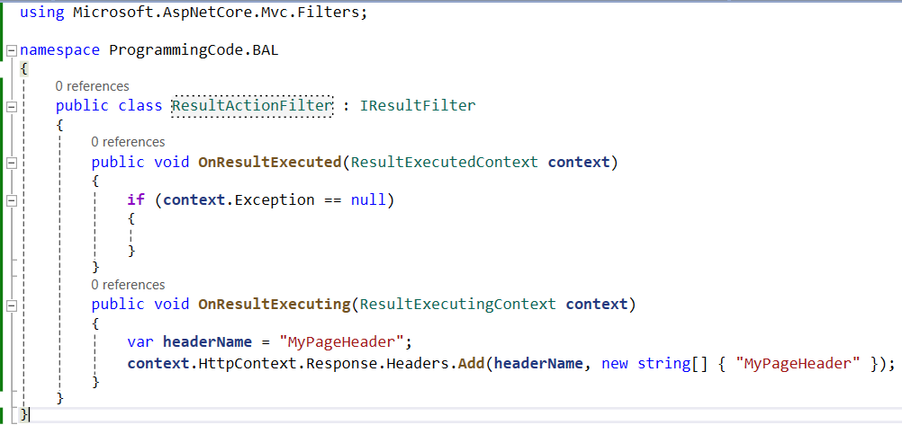
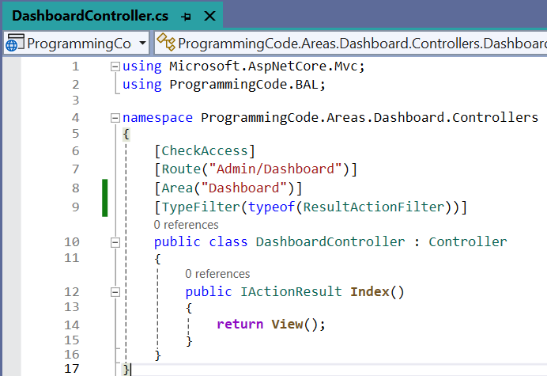
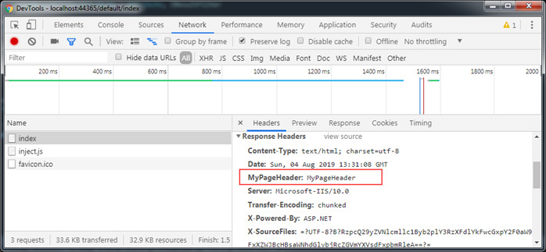
3. Result Filters - Example

Slide 64
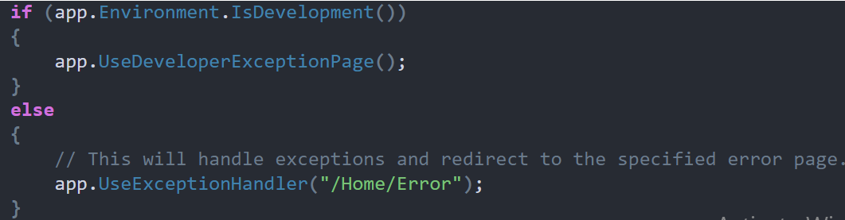
4. Exception Filters
The Exception Filter in the ASP.NET MVC Application is used to handle any exceptions that occur during the ASP.NET MVC Request processing pipeline.
The ASP.NET MVC Framework provides one in-built attribute called HandleError which is basically used to handle the unhandled exception in the MVC application.
It typically used for tasks such as Logging Exceptions, Returning Custom Error Responses, and Performing any other necessary action when an exception occurs.
They provide a way to centralize the exception-handling logic and keep it separate from our controller or middleware components, making our code more organized and maintainable.
To Configure UseExceptionHandler Middleware for Global Exception Handling, please add the following code within the Program class.

Slide 65
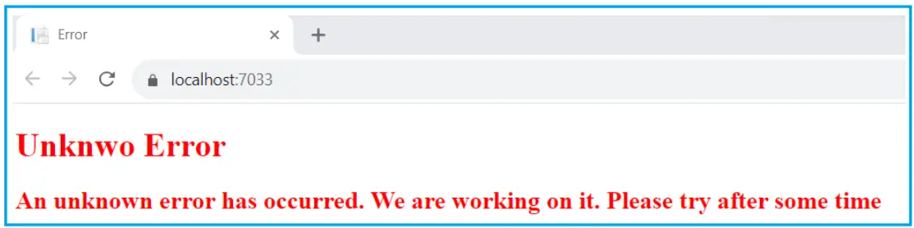
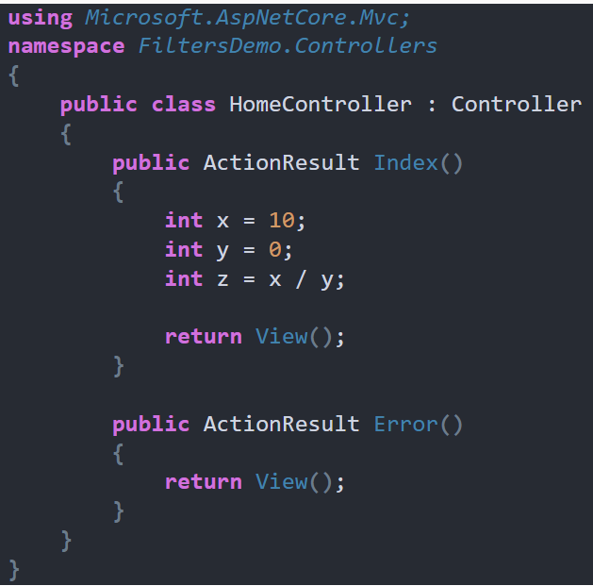
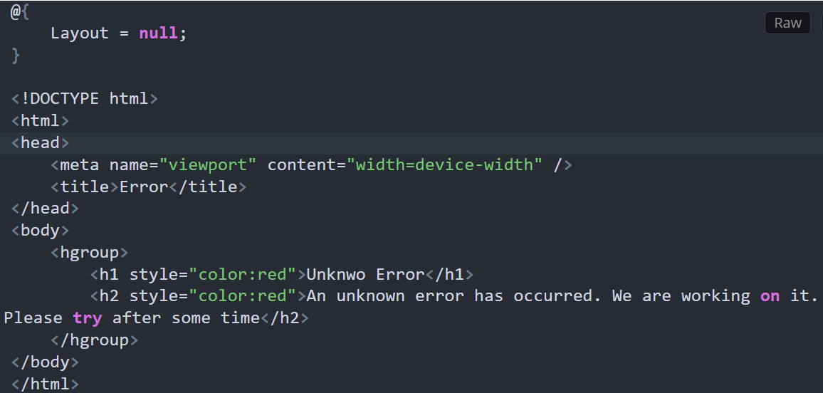
4. Exception Filters Cont..
Next, add the Error.cshtml view of the Home Controller.
Once you add the Error view, copy and paste the following code.
The following view will be executed when your application has an unhandled exception.

Slide 66
Summary

Slide 67
Summary: Helpers in MVC
HTML Helpers
Simplify rendering form elements: @Html.TextBoxFor(), @Html.LabelFor()
Tag Helpers
HTML-like syntax to generate dynamic content.
Example: <input asp-for="Name" />
URL Helpers
Used to generate URLs to actions, routes, or static content dynamically in Razor Views or Controllers.
Simplify linking between pages, actions, and resources using routing.

Slide 68
Summary: Routing & Action Management
URL Routing Overview
Maps URL patterns to controller actions.
Defined in Program.cs
Attribute Routing
Applied directly to controller/actions using [Route("path")].
Action Selectors & Verbs
Select methods using [HttpGet], [HttpPost], etc.
[ActionName("CustomName")] allows aliasing actions.
Action Filters
Run logic before/after an action method.
Types: OnActionExecuting, OnResultExecuted, etc.

Slide 69


